Slide 1
_________ ______________________________ \_ ___ \ / _____/\______ \_ _____/ / \ \/ \_____ \ | _/| __) \ \____/ \ | | \| \ \______ /_______ / |____|_ /\___ / \/ \/ \/ \/
week 3

Slide 2
What is it?
Cross-Site Request Forgery
An attack that tricks the victim into loading a page that contains a malicious request
The attacker can make the victim perform actions that they didn't intend to, such as logout, purchase item, change account information, retrieve account information, or any other function provided by the vulnerable website.

Slide 3
How does it work?
Attacker tricks victim into browsing to their site
Malicious site makes a request in the background
Browsers will automatically include with such requests any credentials associated with the site, such as the user's session cookie, basic auth credentials, IP address, or Windows domain credentials
Therefore, if the user is currently authenticated to the site, the site will have no way to distinguish this from a legitimate user request.

Slide 4
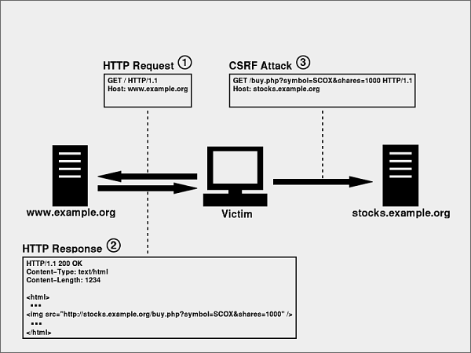

Slide 5
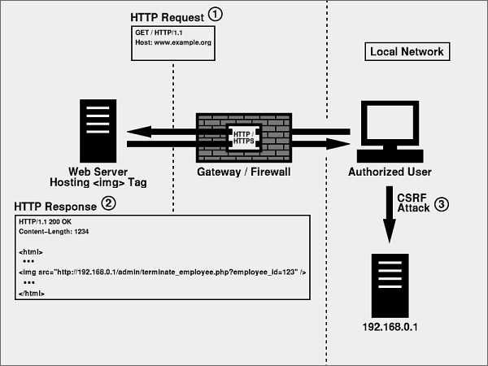

Slide 6
Code example
A bank executes a trade using the following request:
GET http://bank.com/transfer.do?acct=BOB&amount=100 HTTP/1.1
An attacker hides the following in their website:
<img src="http://bank.com/transfer.do?acct=MARIA&amount=100000" width="1" height="1" border="0">

Slide 7
Note
CSRF does not (generally) give attacker access to body of the returned request
It is a one-way attack (for the most part)

Slide 8
Ineffective Prevention
Secret Cookie
Why doesn’t this work?
Only accept POST requests
Why doesn’t this work?
URL rewriting
Why doesn’t this work?
Checking referrer header
Why doesn’t this work?

Slide 9
Effective Prevention
Synchronizer Token Pattern
Send a token with every form/page and re-validate on form submission
Double Submit Cookies
Cookie is set that matches a secret value in the form
Cookie value and form value are matched
Challenge-Response
CAPTCHA
Re-authentication
One-time token
No XSS Vulns!!

Slide 10
Resources
https://www.owasp.org/index.php/Testing_for_CSRF_(OWASP-SM-005)
https://www.owasp.org/index.php/Cross-Site_Request_Forgery_(CSRF)_Prevention_Cheat_Sheet

Slide 11
Demos
Effective CSRF prevention
Ineffective CSRF prevention

